Slide 1
DISPLAY BOOKSHELVES HACKATHON
Sam Geogi 875192
Vivek Unni 875339
Anjana Rajeevan-875286
Jibin Jose – 875329
Anju d-875243
shashank b-875266

Slide 2
Objective
Selenium is the most popularly used open source tool for testing web applications across different browsers and platforms.
The main motive of this project was to use Selenium integrated with Java to automate and test various scenarios for a home furnishing website keeping ‘bookshelves’ as the focal subject.
Website: www.urbanladder.com
In addition, the project also uses:
TestNG as the testing framework.
Build tool Maven to simplify integration of dependencies
Apache POI to implement data driven testing.

Slide 3
Problem Statement
DISPLAY BOOKSHELVES:
The project implemented the following problem statement:
Display the name, price of :-
1. Bookshelves below Rs. 15000
2. Including out of stock
3. Storage type should be open.
4. First 3 study chair details with highest recommendation.
If more than one item with same price displayed, include that details as well.

Slide 4
Hackathon Ideas
DISPLAY BOOKSHELVES:
The project is implemented for the following Hackathon Ideas:
Display the name and price of first 3 Bookshelves below Rs. 15000, with Storage type as open & exclude out of stock.
From Collections, retrieve all items under Being-At-home submenu and store them in a List; display the same.
Gift cards - choose “Birthday/Anniversary"; fill the gift card form details; also, make any one input invalid (example: email) and display the error message.

Slide 5
Test Case 1
Urban Ladder webpage should be launched.Display of bookshelves including out of stocks.
1.Initializing the browser.
2.Opening the URL.
3.Enter “Bookshelves ” in the search bar.
4.Click the search icon.
5.Select “bookshelves” as Category
6. Look for the Price Slider and make it below 15000.
7.Select the Storage type as open.
8. And Display the name and price of first 3 Bookshelves.

Slide 6
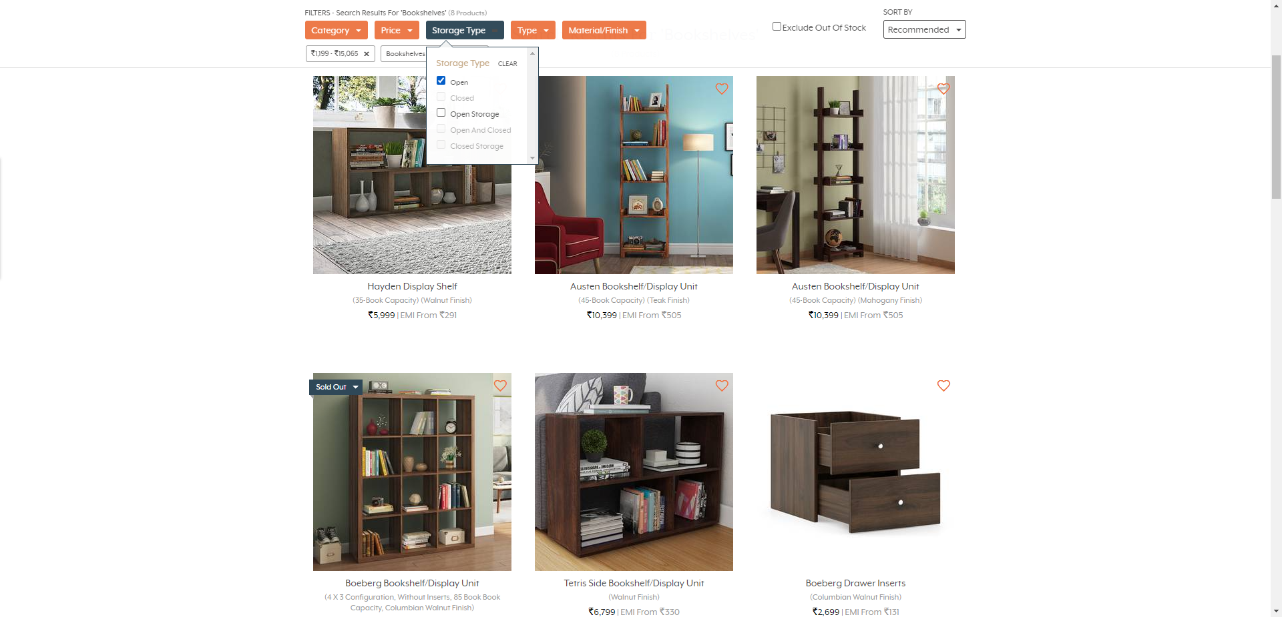

Slide 7
Test Case 2
Display of bookshelves excluding out of stocks.
Look for the Bookshelves icon and click it :-
Steps:-
1.Enter “Bookshelves ” in the search bar.
2 .Click the search icon.
3.Mouse hover to storage menu and select Bookshelves under Living Storage
4.Look for the Price Slider and make it below 15000.
5.Select the Storage type as open.
6.Click on the Exclude out of stock check box.
7. And Display the name and price of first 3 Bookshelves.

Slide 8
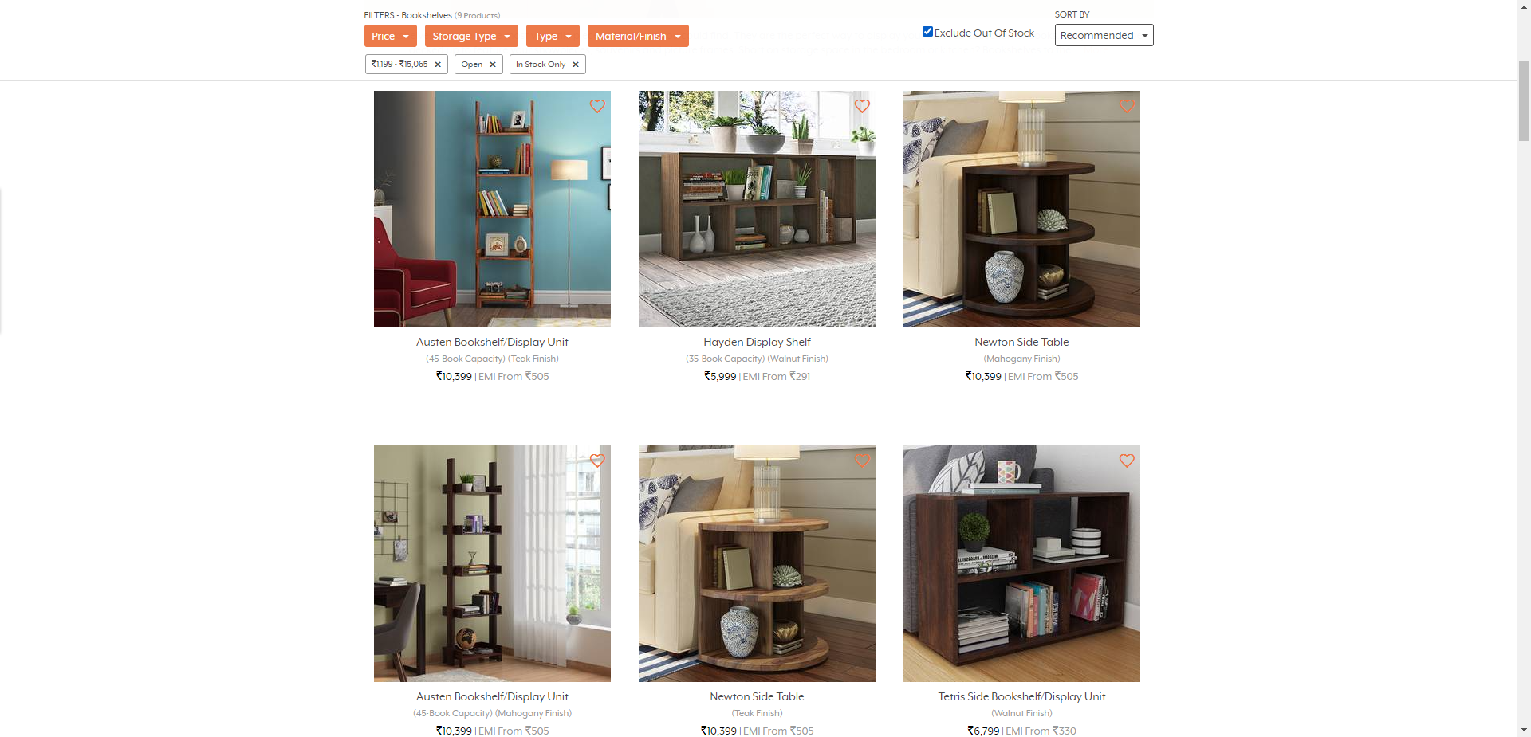
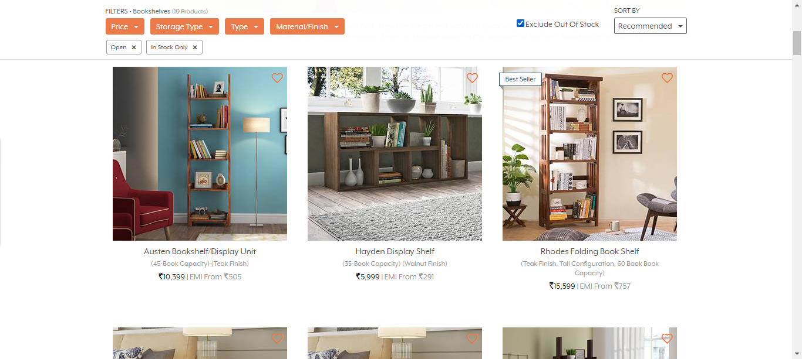

Slide 9
Test Case 3
Set the required conditions as per Second Hackathon Idea:-
Steps:-
1.Search for Collections.
2.Look for Being-At-Home Category.
3.Retrieve all the items and store it in a List.
4.Display the List.

Slide 10
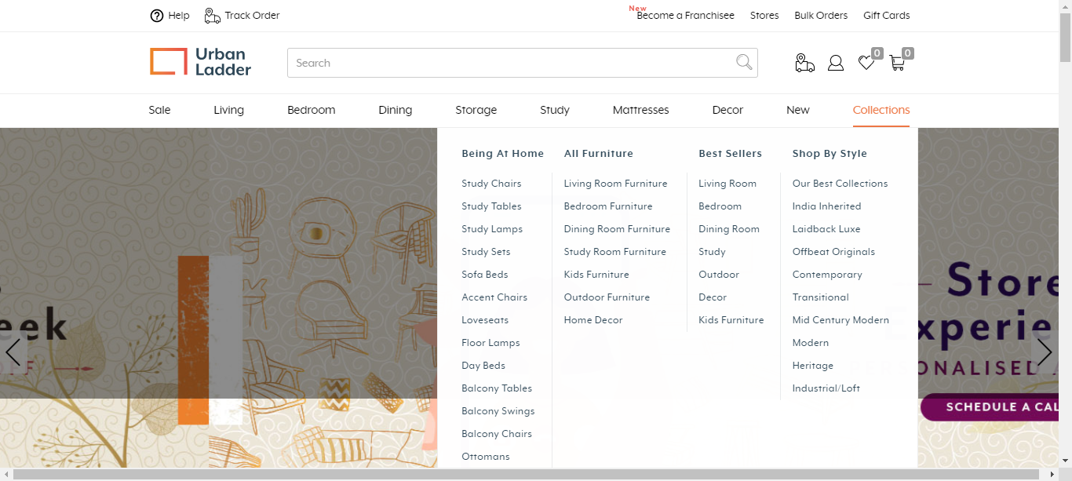

Slide 11
Test Case 4
Set the required conditions as per Third Hackathon Idea:-
Steps:-
1.Search for Gift Cards and Click.
2.Look for Birthday/anniversary and Click.
3.Now fill all the details with any one detail incorrectly filled.
4.Search for the error message and Display.

Slide 12
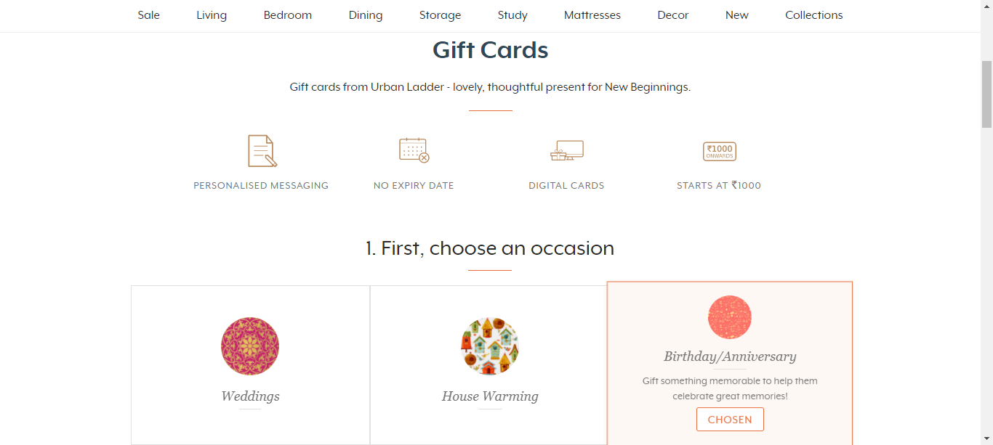

Slide 13
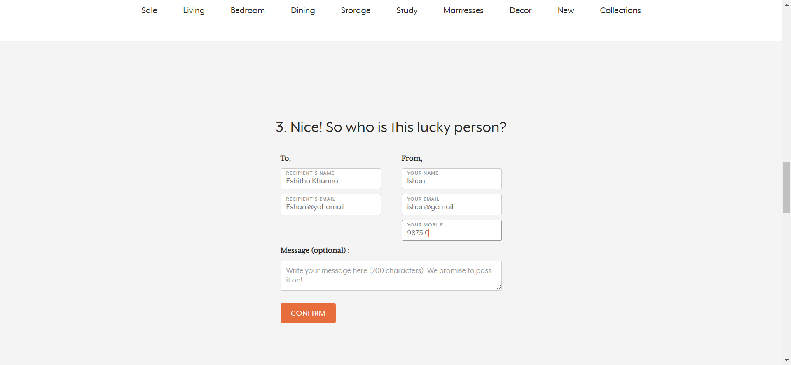

Slide 14
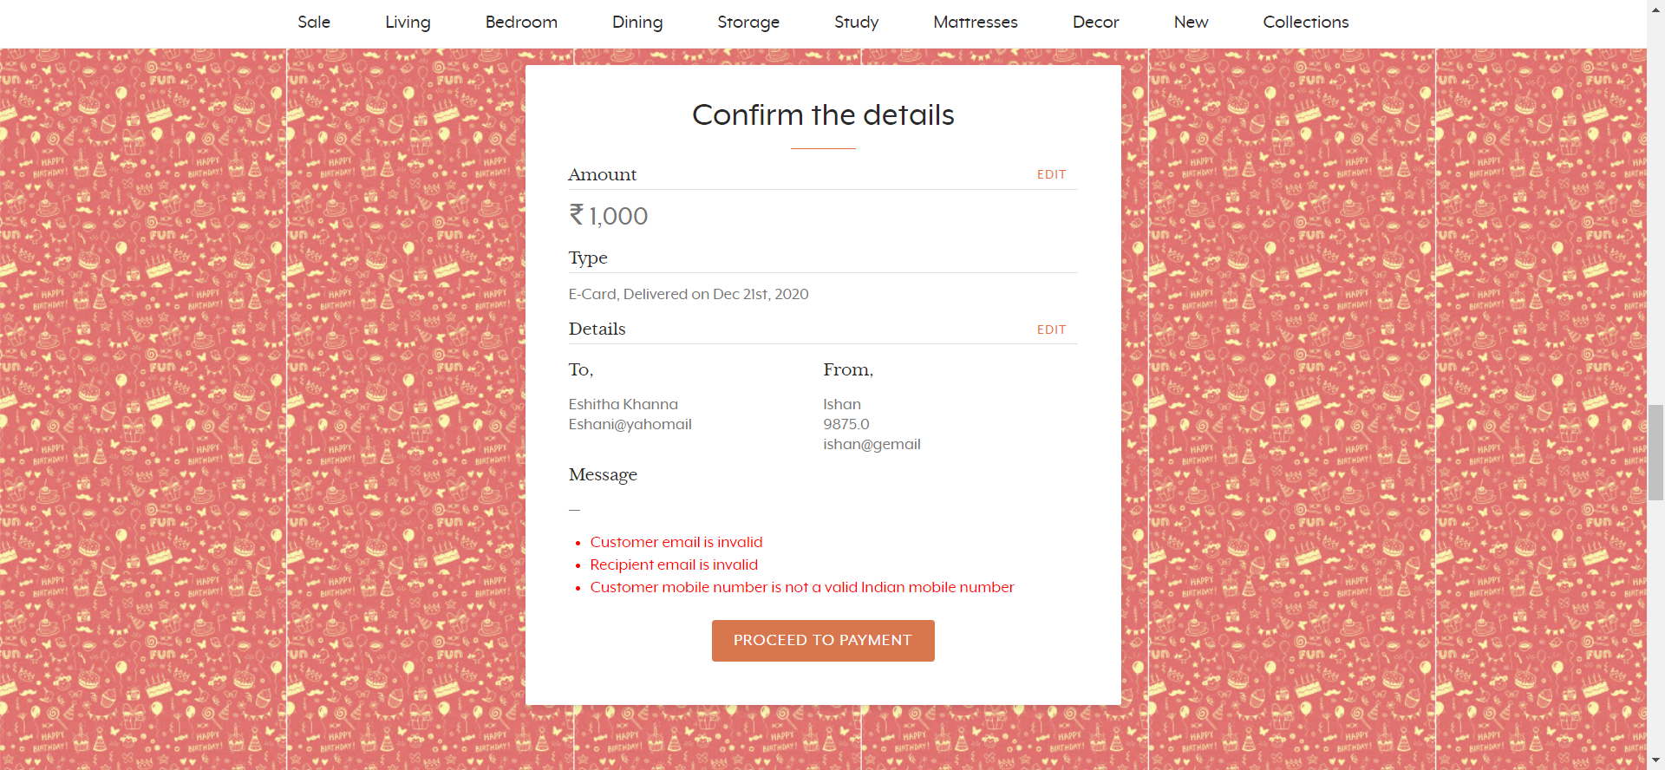

Slide 15
Test Case 5
Set the required conditions as per Third Hackathon Idea:-
Steps:-
1.Search for Gift Cards and Click.
2.Look for Birthday/anniversary and Click.
3.Now enter valid data to all the fields.

Slide 16
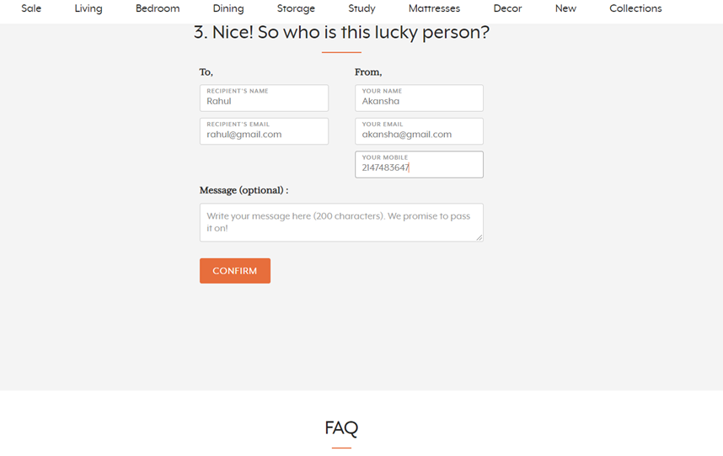

Slide 17
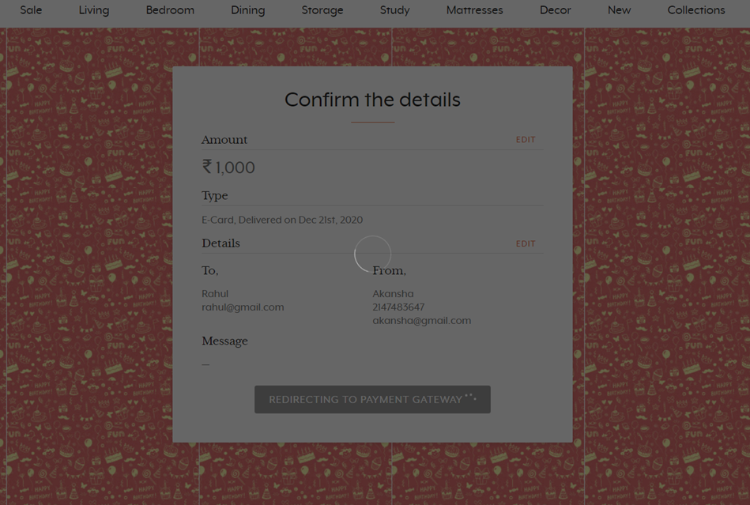

Slide 18
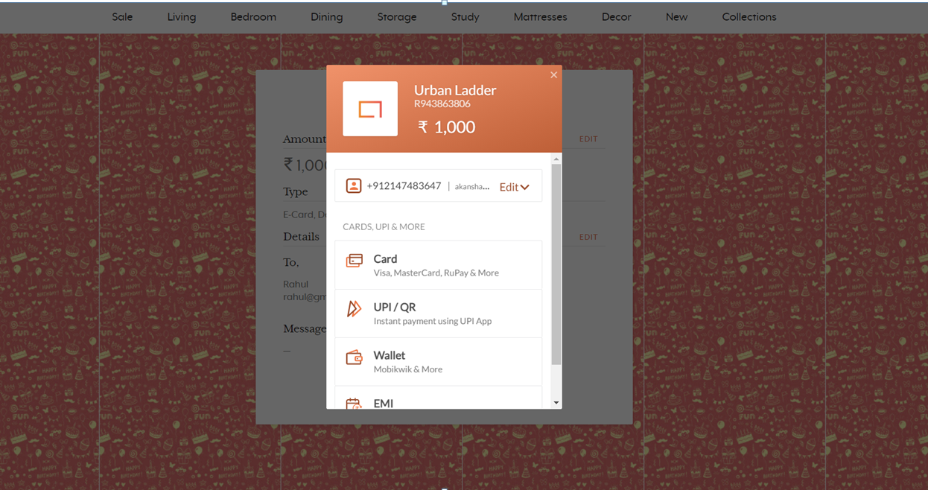

Slide 19
Test Case 6
Set the required conditions as per fourth Problem Statement.
1.Enter “Study chairs ” in the search bar.
2.Click the search icon.
3.Select “Recommended” from the Sort By drop down list.
4.And Display the name and price of first 3 Study Chairs.

Slide 20
